Slide 1
Data Visualization

Slide 2
Agenda
Visualization using MatplotLib
Visualization using Seaborn
Visualization using Plotly

Slide 3
Data visualization
Representation of the data in a pictorial or graphical format
First step of data analysis
Allow us to get the intuitive understanding of the data
Helps to visualize the patterns in the data

Slide 4
Visualization using Matplotlib

Slide 5
Introduction to matplotlib
It is a Python’s 2D plotting library
‘pyplot’ is a subpackage of matplotlib that provides a MATLAB-like way of plotting
Provides a simple way of plotting the various plots like histogram, bar plot, scatter plot

Slide 6
Installation
Open terminal program (for Mac user) or command line (for Windows) and install the matplotlib using the command:
conda install matplotlib
Or
pip install matplotlib

Slide 7
Installation
Alternatively, you can install matplotlib in a jupyter notebook using below code:
!pip install matplotlib
To import subpackage ‘pyplot’, use the command:
import matplotlib.pyplot as plt

Slide 8
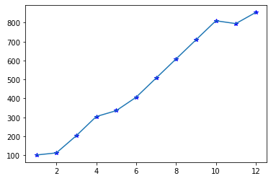
Line plot
It is a simple plot that displays the relationship between two variables

Slide 9
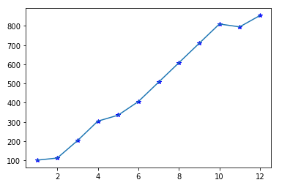
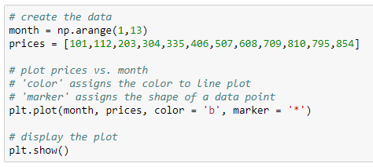
Plot a line plot from a list
Plot a line plot to visualize the price trend of a product over a year
Plot the line plot using the plot() method

Slide 10
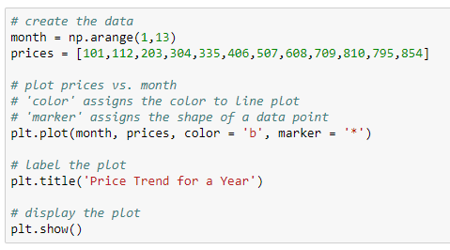
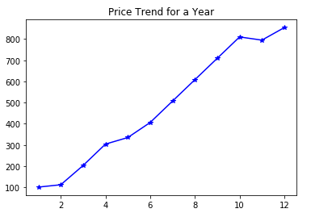
Add title of the graph
Put a title to the plot

Slide 11
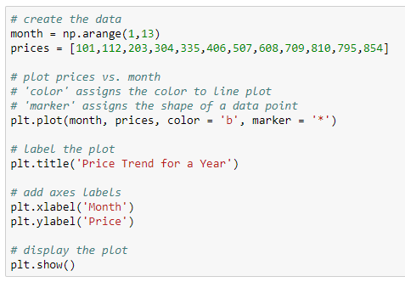
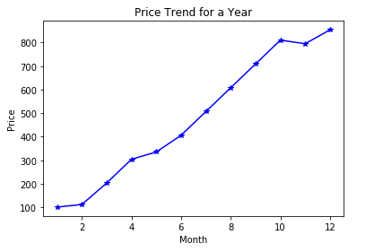
Add axes labels
Add labels to x and y axis

Slide 12
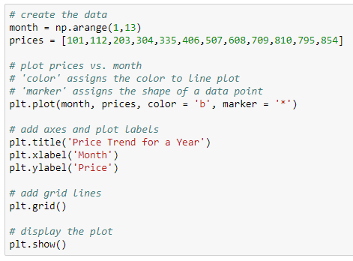
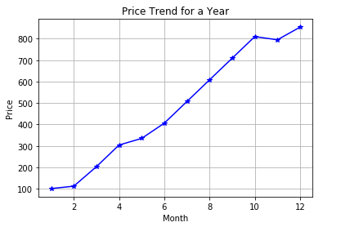
Add grid lines to the plot
Add grid lines

Slide 13
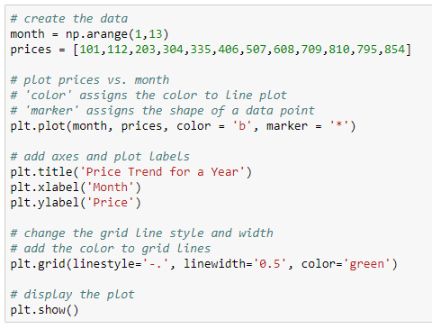
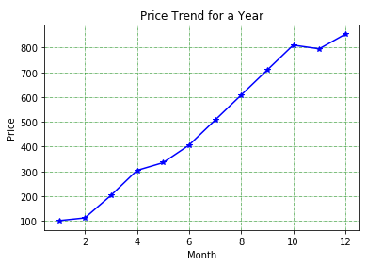
Customize the grid lines
Change style, width and color of grid lines

Slide 14
Multiple line plots
Plot the multiple line plots to represent the sales of each company recorded on the four different days. Use the data below to plot a graph:
Day | Sales
 | Vivo | Oppo | Samsung | Micromax
Day1 | 80000 | 75000 | 45000 | 47000
Day2 | 78000 | 44000 | 45000 | 55000
Day3 | 87000 | 58000 | 60333 | 78000
Day4 | 95000 | 40888 | 54000 | 65700

Slide 15
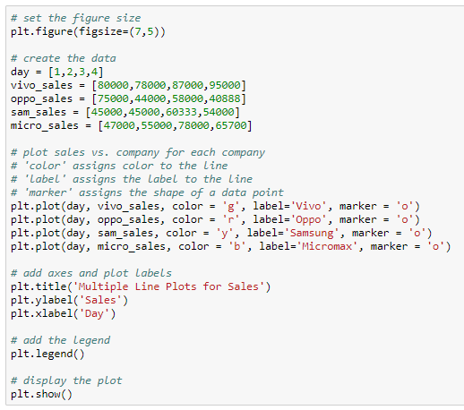
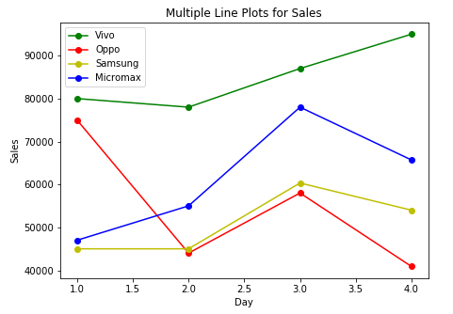
Multiple line plots
Each line represents the sales of a company for four days
Set the plot size
Plot multiple line plots

Slide 16
Scatter plot
It is used to display the relationship between two numeric variables
Used to represent the extent of correlation between two variables
Used to detect the extreme points in the data

Slide 17
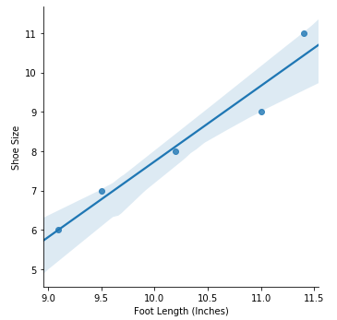
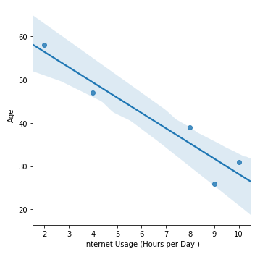
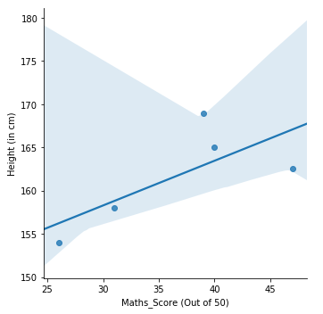
Scatter plot
Scatter plots explaining the different types of correlation between the variables:
Positive Correlation
( 𝜌 = 0.97167252 )
Negative Correlation
( 𝜌 = -0.95056151 )
No Correlation
( 𝜌 = 0.09919779 )

Slide 18
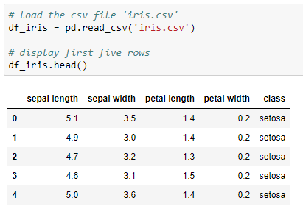
Read the data
Use the iris data to create the scatter plot

Slide 19
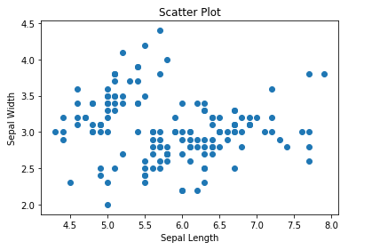
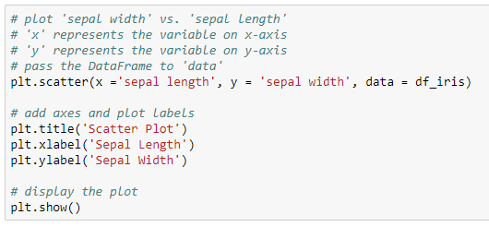
Scatter plot
Use the scatter() method to create scatter plot in matplotlib
Set the variables on x and y axis
There is no significant correlation between ‘sepal length’ and ‘sepal width’

Slide 20
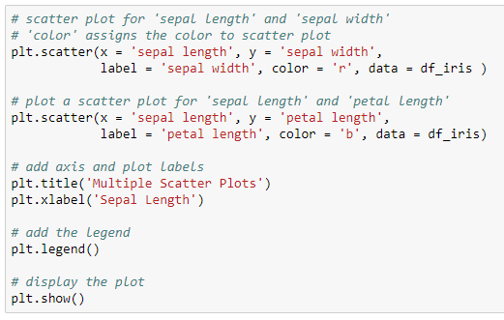
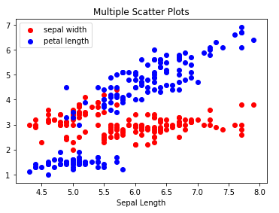
Multiple scatter plots
Add the legend
The plot shows the positive relationship between ‘sepal length’ and ‘petal length’

Slide 21
Bar plot
It is used to display the categorical data with bars of lengths proportional to the values that they represent
Used to compare the different categories of the categorical variable
One axis displays the categorical variable and another displays the value for each category

Slide 22
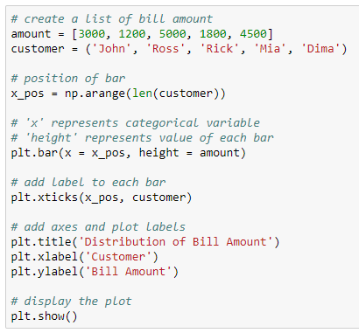
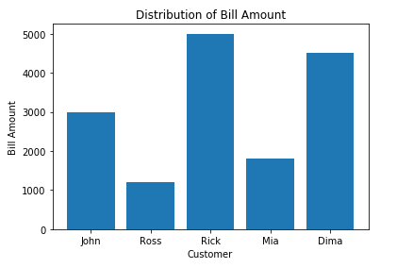
Bar plot
The bar displays the bill amount by customer
Returns a vertical bar plot

Slide 23
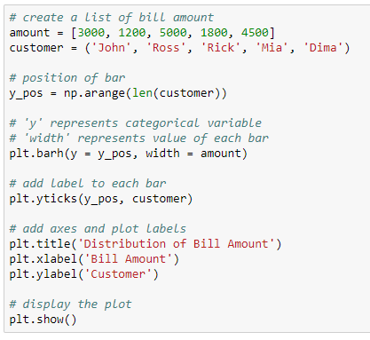
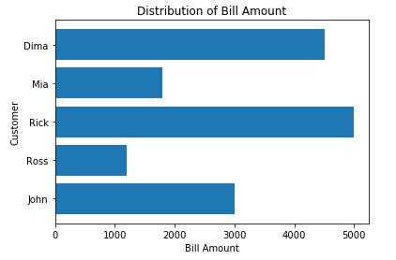
Horizontal bar plot
Plot the chart horizontally using the barh() method
Returns a horizontal bar plot

Slide 24
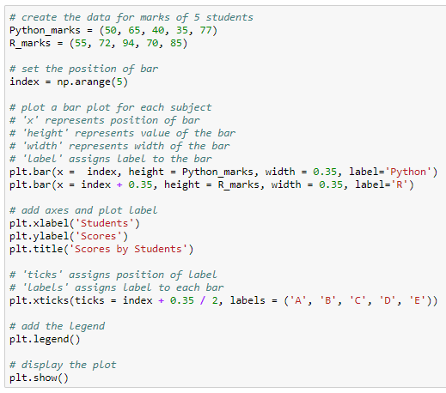
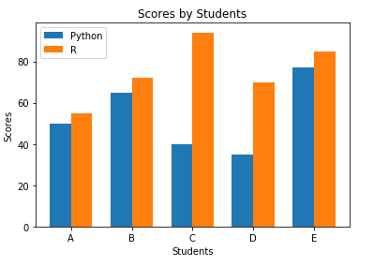
Grouped bar plot
Compare the marks of the students in R and Python
Plot the bar plot for each subject

Slide 25
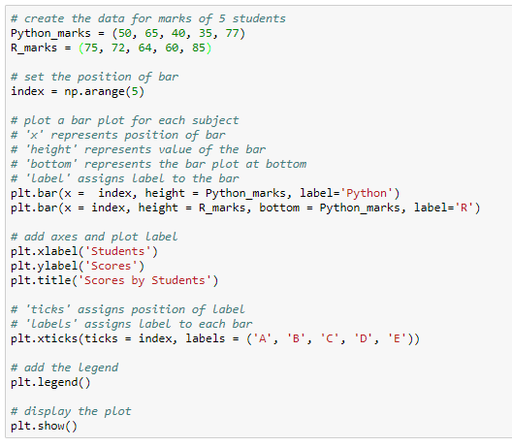
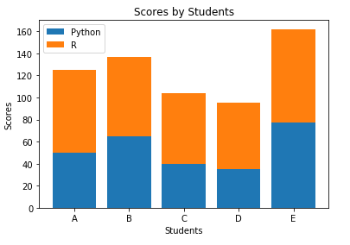
Stacked bar plot
Plot the ‘R_marks’ above the ‘Python_marks’

Slide 26
Pie plot
It is a circular graph divided into sections displaying the numeric proportion
It is used to display the univariate data
Each section of the pie plot represents a single category in the data

Slide 27
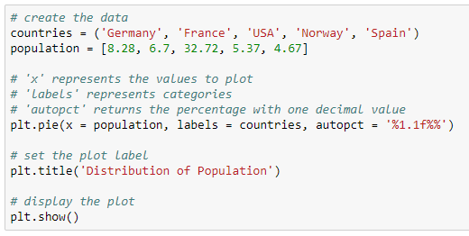
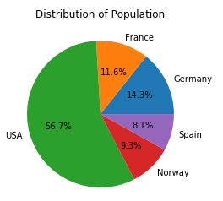
Pie plot
Plot a pie plot to study the population proportion for different countries
Add the percentage with value to tenth place

Slide 28
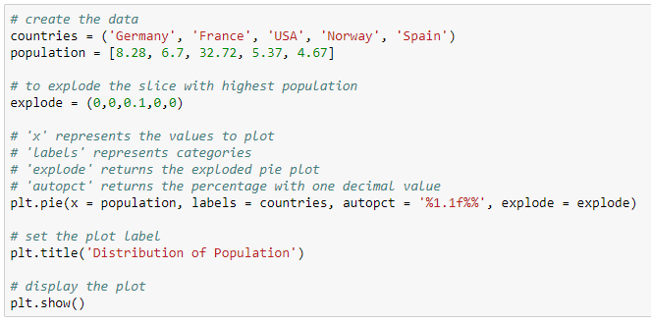
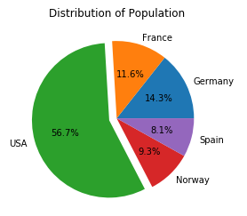
Exploded pie plot
It is a type of pie plot in which one or more sectors are separated from the disc
Explode the country with highest population

Slide 29
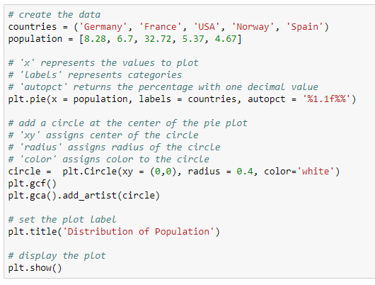
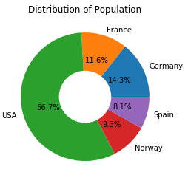
Donut pie plot
It is a type of pie plot with a hollow center representing a doughnut
Add circle to current figure

Slide 30
Histogram
It is used to represent the distribution of the numeric variable
It is an estimate of the probability distribution of a continuous data
One axis represents the variable in the form of bars and another represents the frequency each bar
There are no gaps between the bars of the histogram

Slide 31
Read the data
Use the iris data to create the histogram

Slide 32
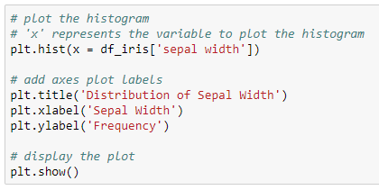
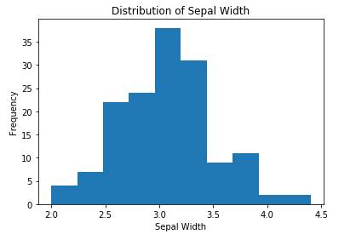
Histogram
Plot the histogram to check the distribution of the variable, ‘sepal width’
Approximately 3 - 3.2 cm is the most occuring sepal width in the data

Slide 33
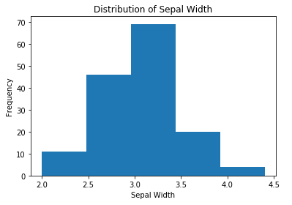
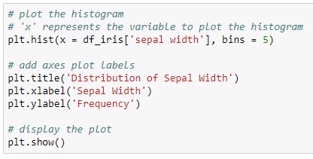
Histogram
Plot a histogram with 5 bins (bars)
‘bins’ returns a histogram with specified number of bars

Slide 34
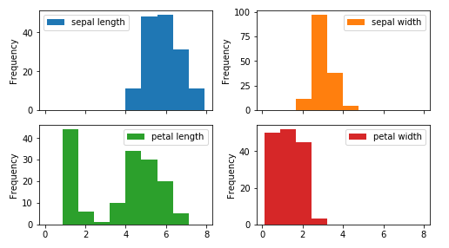
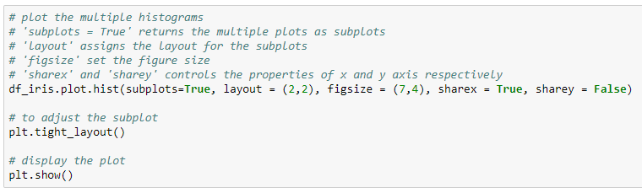
Create multiple histograms
Number of rows and columns to plot the subplots
X-axis ticks are same for all subplots
Y-axis ticks are different for all subplots

Slide 35
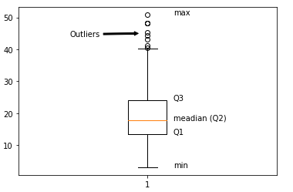
Box plot
It is used to visualize the distribution of the numeric variable
Represents the five number summary of the variable which includes the minimum, first quartile (Q1), second quartile (median), third quartile (Q3) and maximum of the variable
Used to detect the outliers (extreme values) in the data

Slide 36
Read the data
Use the iris data to create the box plot

Slide 37
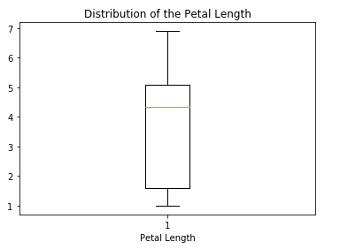
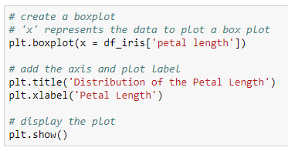
Box plot
Check the distribution of the variable ‘petal length’
median
The box plot shows that the variable ‘petal length’ is negatively skewed

Slide 38
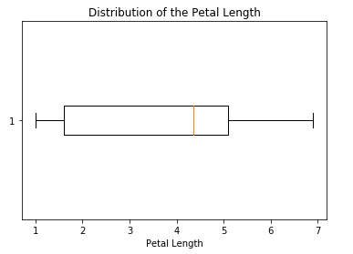
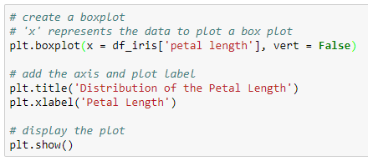
Horizontal box plot
Check the distribution of the variable ‘petal length’
Returns the horizontal box plot
median
The box plot shows that the variable ‘petal length’ is negatively skewed

Slide 39
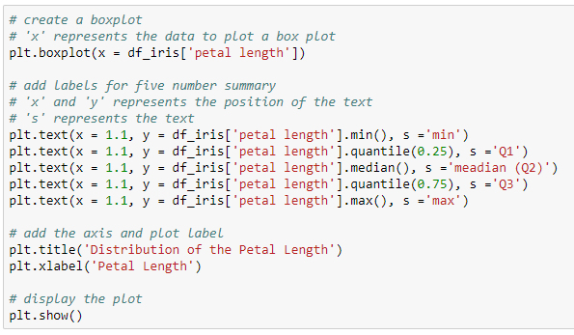
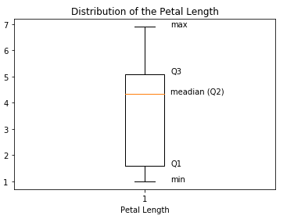
Add five number summary to box plot
Add text to the plot

Slide 40
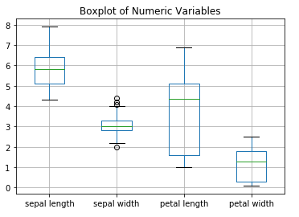
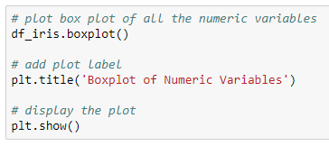
Box plot
Plot the boxplot of all the numeric variables in the data
The boxplot of ‘sepal width’ shows the presence of outliers below and above the whiskers

Slide 41
Area plot
It is similar to a line plot where the area under the line is shaded
It is used to study the time series data

Slide 42
Read the data
Use the iris data to create the area plot

Slide 43


Area plot
Calculate the frequency and sort the values to plot the area plot

Slide 44
Visualization using Seaborn

Slide 45
Introduction
Seaborn is used for data visualization
It is based on the matplotlib
It provides a high-level interface for drawing attractive and informative statistical graphics

Slide 46
Functionalities of seaborn
Allows comparison between multiple variables
Supports multi-plot grids
Univariate and bivariate visualization
Availability of different color palettes
Estimates and plots linear regression line

Slide 47
Installation
Open terminal program (for Mac user) or command line (for Windows) and install it using following command:
conda install seaborn
Or
pip install seaborn

Slide 48
Installation
Alternatively, you can install seaborn in a jupyter notebook using below code:
!pip install seaborn
To import the library, use the command:
Import seaborn as sns

Slide 49
Strip plot
It is similar to the scatter plot with one categorical variable
It is used to understand the underlying distribution of the data
One axis represents the categorical variable and another represents the value corresponding to the categories

Slide 50

Read the data
Load the titanic data to create a strip plot

Slide 51


Strip plot
Check the distribution of age based on gender
The plot shows that, the maximum age of males is higher than of females

Slide 52


Strip plot
Add the one more categorical variable to strip plot using the parameter, ‘hue’
Add a categorical variable
Proportion of female survivors is higher than males

Slide 53
Violin plot
It is similar to a boxplot, that displays the kernel density estimator of the underlying distribution
It shows the distribution of the quantitative data across categorical variables such that those distributions can be compared

Slide 54
Read the data
Load the titanic data to create a violin plot

Slide 55


Violin plot
Plot the violin plot to compare the distribution of age based on gender
The box plot is plotted inside the violin plot

Slide 56


Violin plot
Violin plot can be divided into two halves, where one half represents surviving while other half represents the non-surviving passenger
Pass ‘True’ as value for the split parameter

Slide 57
Swarm plot
It is the combination of strip and violin plots
The points are adjusted in such a way that they don't overlap, which gives the better representation of the data

Slide 58
Read the data
Load the titanic data to create a swarm plot

Slide 59


Swarm plot
Create a swarm plot for the distribution of age based on gender
High proportion of males are in the age range 20 - 40

Slide 60


Swarm plot
Add one more categorical variable ‘Survived’ to the swarm plot using the parameter, ‘hue’

Slide 61
Pair plot
It displays the pairwise relationship between the numeric variables
The pairplot() method creates a matrix; where the diagonal plots represent the univariate distribution of each variable and the off-diagonal plots represent the scatter plot of the pair of variables

Slide 62
Read the data
Use the iris data to create the pair plot

Slide 63


Pair plot

Slide 64
Distribution plot
It displays the distribution of the data
It is a variation of histogram that uses kernel smoothing to plot values, allowing for smoother distributions by smoothing out the noise

Slide 65
Read the data
Load the titanic data to create a distribution plot

Slide 66


Distribution plot
The distplot() method plots the histogram with a Kernel Density Estimator (KDE), which is a used to estimate the probability distribution function of a random variable
KDE
The plot shows the positive skewness of the ‘Fare’

Slide 67


Distribution plot
Plot the distribution of ‘Fare’ without the kernel density estimator (KDE)
Returns the plot without kde

Slide 68


Count plot
It is similar to the bar plot. However, it shows the count of the categories in a specific variable
Calculate the gender-wise percentage upto 2 decimals

Slide 69


Regression plot
It is used to study the relationship between the two variables with the regression line

Slide 70


Point plot
It represents an estimate of central tendency (by default, mean) by position of scatter points and provides the indication of the uncertainty around that estimate using error bars
Error bar

Slide 71


Joint plot
A joint plot is a bivariate plot along with the distribution plot along the margins

Slide 72
Heatmap
A heatmap is a two-dimensional graphical representation of data where the individual values that are contained in a matrix are represented by the different colors
Heatmap for correlation shows the correlation between the variables on each axis

Slide 73
Read the data
Use the iris data to create the heatmap

Slide 74


Heatmap
Add values to the heatmap
Assigns color to each cell
The variables ‘petal width’ and ‘petal length’ are highly positively correlated

Slide 75
Heatmap
Diagonal cells represent the correlation of the variable with itself; thus, the value will always equal to 1
The off-diagonal entries represent the correlation between the pair of variables
The color bar beside the heatmap shows that the dark blue color represents the positive correlation (near to +1) and light blue color represent the negative correlation (near to -1)

Slide 76
Visualization using Plotly

Slide 77
Plotly
Plotly allows us to make beautiful, interactive, explorable charts
It is an open-source and browser-based graphing library
We can get the values on the graph by hovering over the graph

Slide 78
Plotly
Import the offline version of plotly as:
Import the subpackage ‘express’ as:

Slide 79
Read the data
Load the titanic data for further manipulations:

Slide 80


Bar plot
Plot a bar plot to get the gender-wise count of passengers
Male population is more in the data than female population

Slide 81


Histogram
Plot a distribution of fare of the passengers
The histogram shows the positive skewness in the ‘Fare’. There are few extreme points near to Fare = 500

Slide 82
Read the data
Use the iris data for further manipulations:

Slide 83


Boxplot
The boxplot shows that, the ‘sepal length’ is not significantly skewed

Slide 84


Scatter plot
The plot shows that, the variables ‘petal length’ and ‘petal width’ are positively correlated

Slide 85
Thank You

